Slide 1


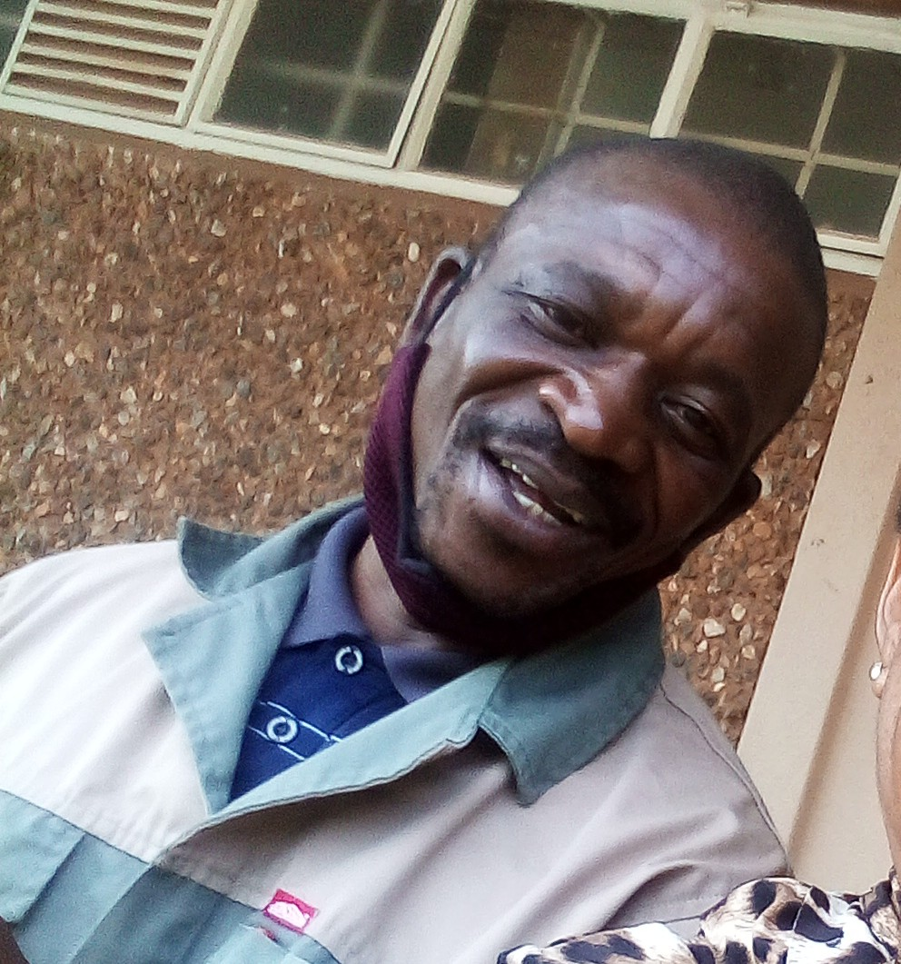
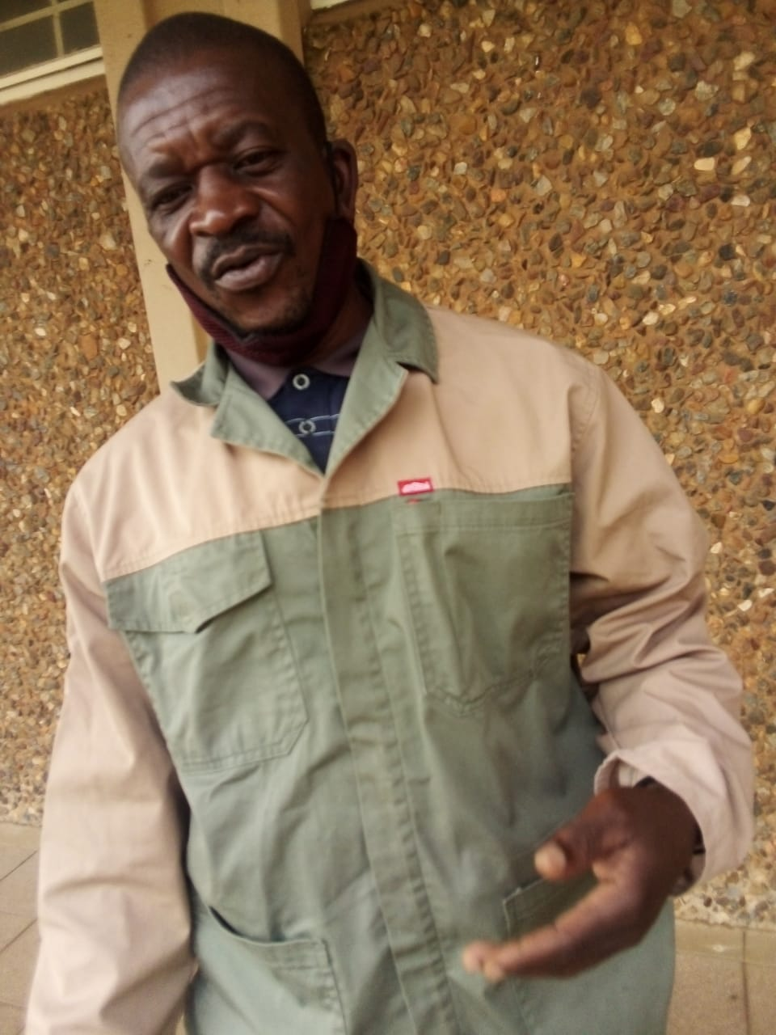
IN LOVING MEMORY
20 December 1970 - 15 January 2022
Mr Alfred Mduli
Alfred started to work at Randfontein Campus on 13 November 1991 as a General Assistant. He will be well remembered as a loyal and devoted staff member.
Memorial Service
Date : 25 January 2022
Venue: Randfontein Campus-SSS Hall
Time: 12:00
Dress Code: Black and a touch of Royal Blue
“Blessed are those who mourn,
for they shall be comforted…” Matthew 5:4
Western TVET College – Management and staff

