Slide 1


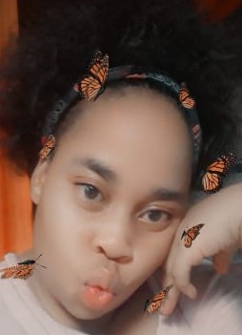
IN LOVING MEMORY
20 February 2001 - 27 January 2022
Miss Lebogang Moleme
Lebogang Moleme was a N6 Human Resources Management student at Randfontein Campus.
Memorial Service
Date : 3 February 2022
Venue: Randfontein Campus-SSS Hall
Time: 13:00
Dress Code: Black and a touch of Red
Funeral Service
Date: 5 February 2022
Time and Venue to be confirmed
“Blessed are those who mourn,
for they shall be comforted…” Matthew 5:4
Western TVET College – Management and staff

